Slide 1
Leveraging Rancher Federal within the DoD and U.S. Government
Zack Brady – Field Engineer zack.brady@rancherfederal.com

Slide 2
Introductions/Overview
What’s a Container? Kubernetes?
Why RGS?
What’s Rancher?
The Rancher Approach
Demo/Workshop (my favorite)
Q&A Session
Today’s Agenda

Slide 3
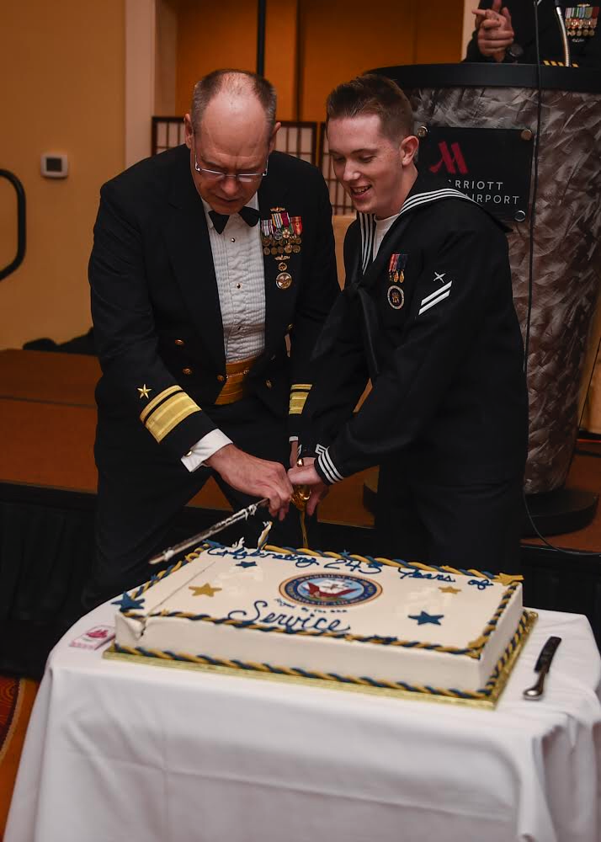
About me…
DoD/IC Contractor
U.S. Military Veteran
Built/Exited a Digital Firm
Open-Source Contributor
Career of Software/DevOps
Active Volunteer FF/EMT
Zack Brady – Field Engineer zack.brady@rancherfederal.com

Slide 4
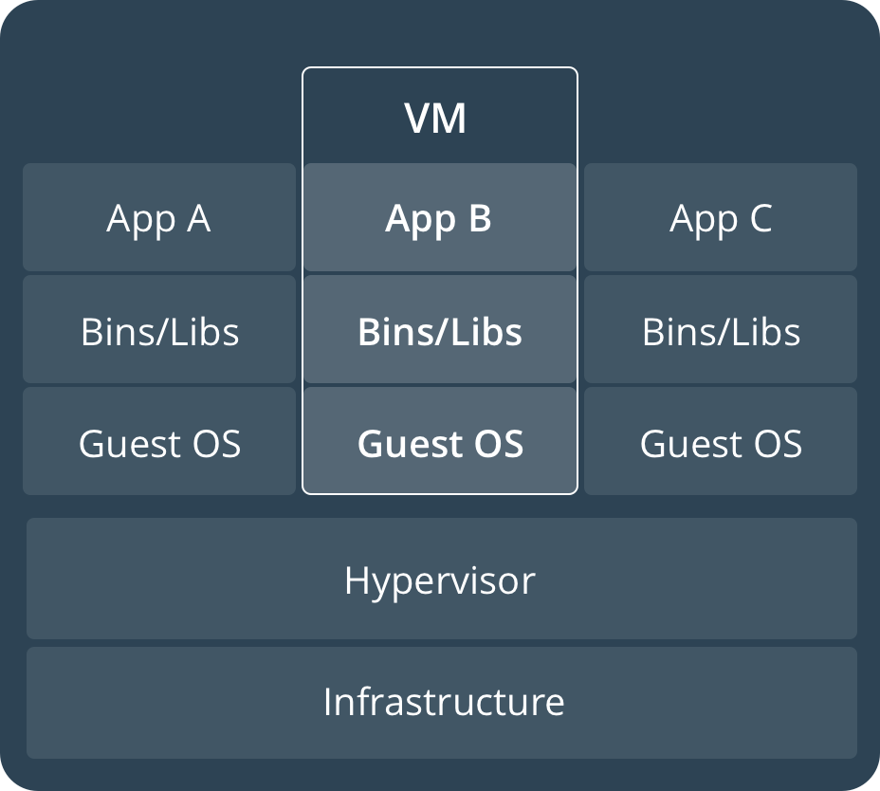
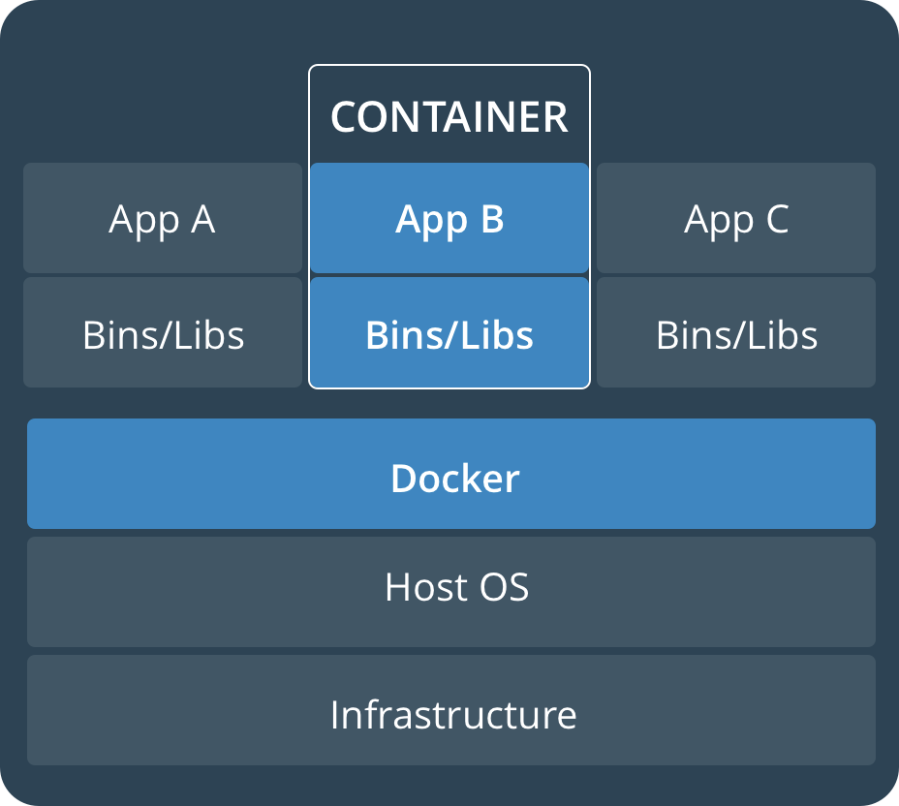
VMs? Containers? Kubernetes!

Slide 5
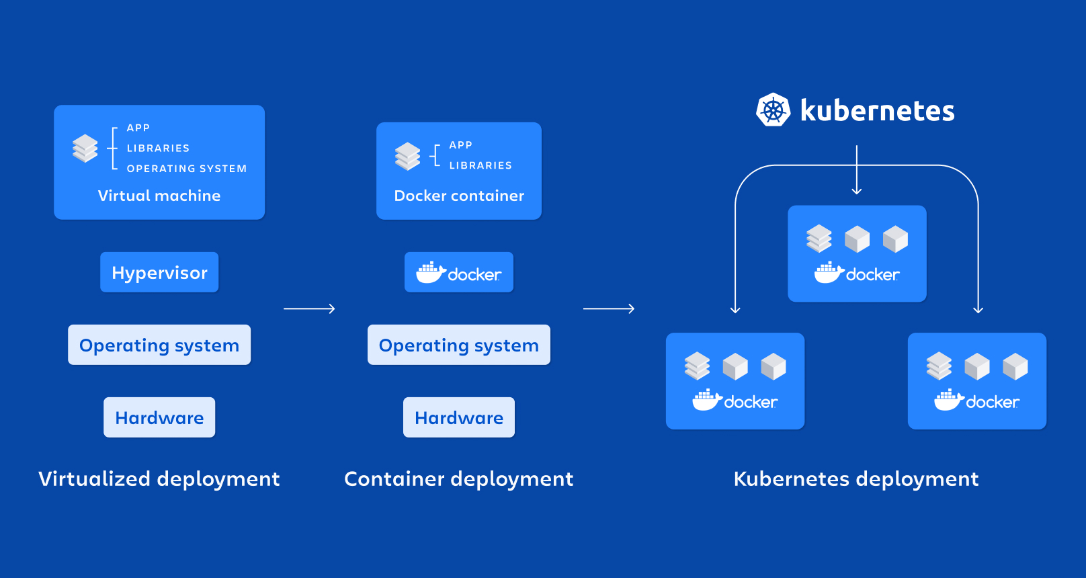
VMs? Containers? Kubernetes!

Slide 6
What is Rancher Government? (RGS)
Rancher Government is a 100% U.S. entity dedicated to delivering Kubernetes and Cloud Native Technology solutions and support across the Federal, DoD/IC, and Public Sector community.
Rancher Government offers varying levels of service and support including U.S. CONUS Support and Cleared Support (Full-Time, Part-Time, and Contract).
Rancher Government exists to enhance Rancher’s capabilities to meet the ever-evolving Federal, Department of Defense, Intelligence Community, and Public Sector mission requirements by:
PKI Authentication
STIG/CIS Benchmarks Hardening
SELinux/FIPS Compliance
Enterprise Auditing Functionality
C2S, SC2S, GovCloud, Airgapped, and Special Enclave Support
Automated Upstream Image Vulnerability Scanning

Slide 7



Rancher’s Pillars of Success
Enterprise Support
24/7 U.S. Enterprise Support for Rancher & Ecosystem
Technical Account Manager & Bootstrap Architecture and Infrastructure Support
Fully Cleared Support
70% of RGS of TS/SCI
Continuous Training (CE)
Mission Accelerator
Dedicated to the Rancher Portfolio to work for Airgap, Classified, and Mission
Security-first mindset to the Rancher capabilities by baking in NIST FIPS-140-2/3 Encryption and DISA STIG certification
Collaborated to develop the RKE Gov/RKE2 secure-by-default Kubernetes distribution
Professional Services
Fully Onsite or Remote FTE and Temporary Engineers
Cloud Advocates and Evangelists focused on bootstrapping or delivering customer success
Multiple Prime Contracts around the IC/DoD
Primed at USAF Platform One

Slide 8












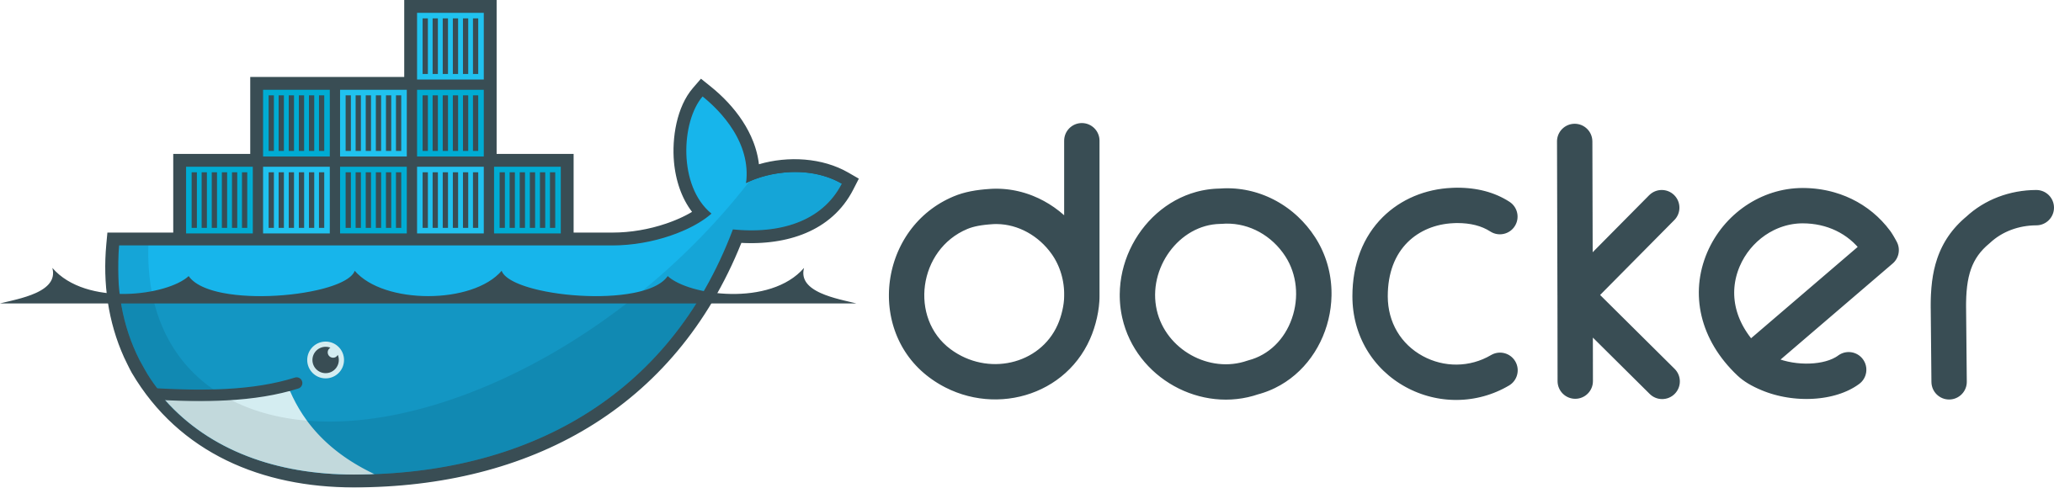



Rancher SLA
Authentication & Authorization
App Management & CI/CD
Monitoring & Logging
The Complete Rancher Ecosystem
Registry & Image Scanning
*
Container Security & Secrets
Networking & Service Mesh
*
Platforms & Orchestration
Container Engine
*
Operating Systems
Persistent Storage
Infrastructure Drivers

Slide 9
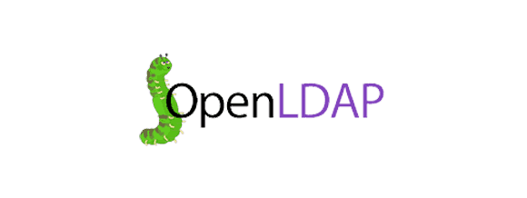










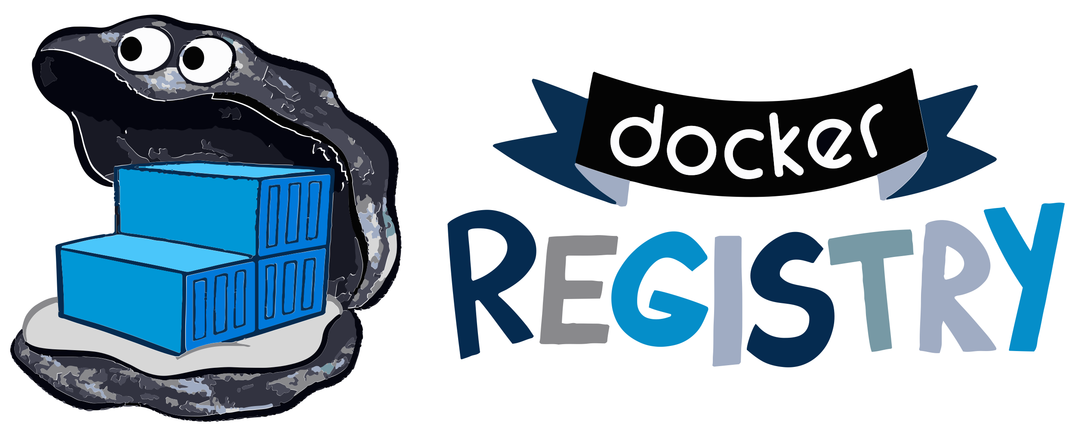



















Rancher Supported Partners
Rancher SLA
Certified Integrations
Authentication & Authorization
*
App Management & CI/CD
Monitoring & Logging
Registry & Image Scanning
Container Security & Secrets
Networking & Service Mesh
Platforms & Orchestration
GKE
AKS
Container Engine
Operating Systems
Persistent Storage
Infrastructure Drivers

Slide 10
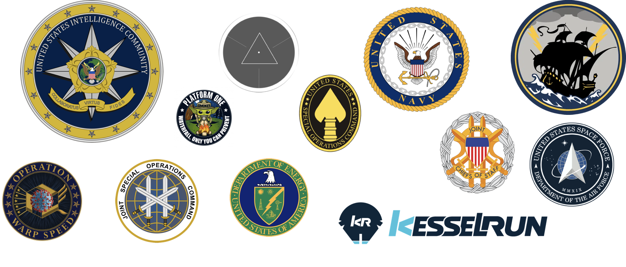
Stressed about STIG’s? Worried about ATO’s?

Slide 11

Break!!
and then our…
Demo/Workshop!
https://workshop.rancherfederal.io/

Slide 12
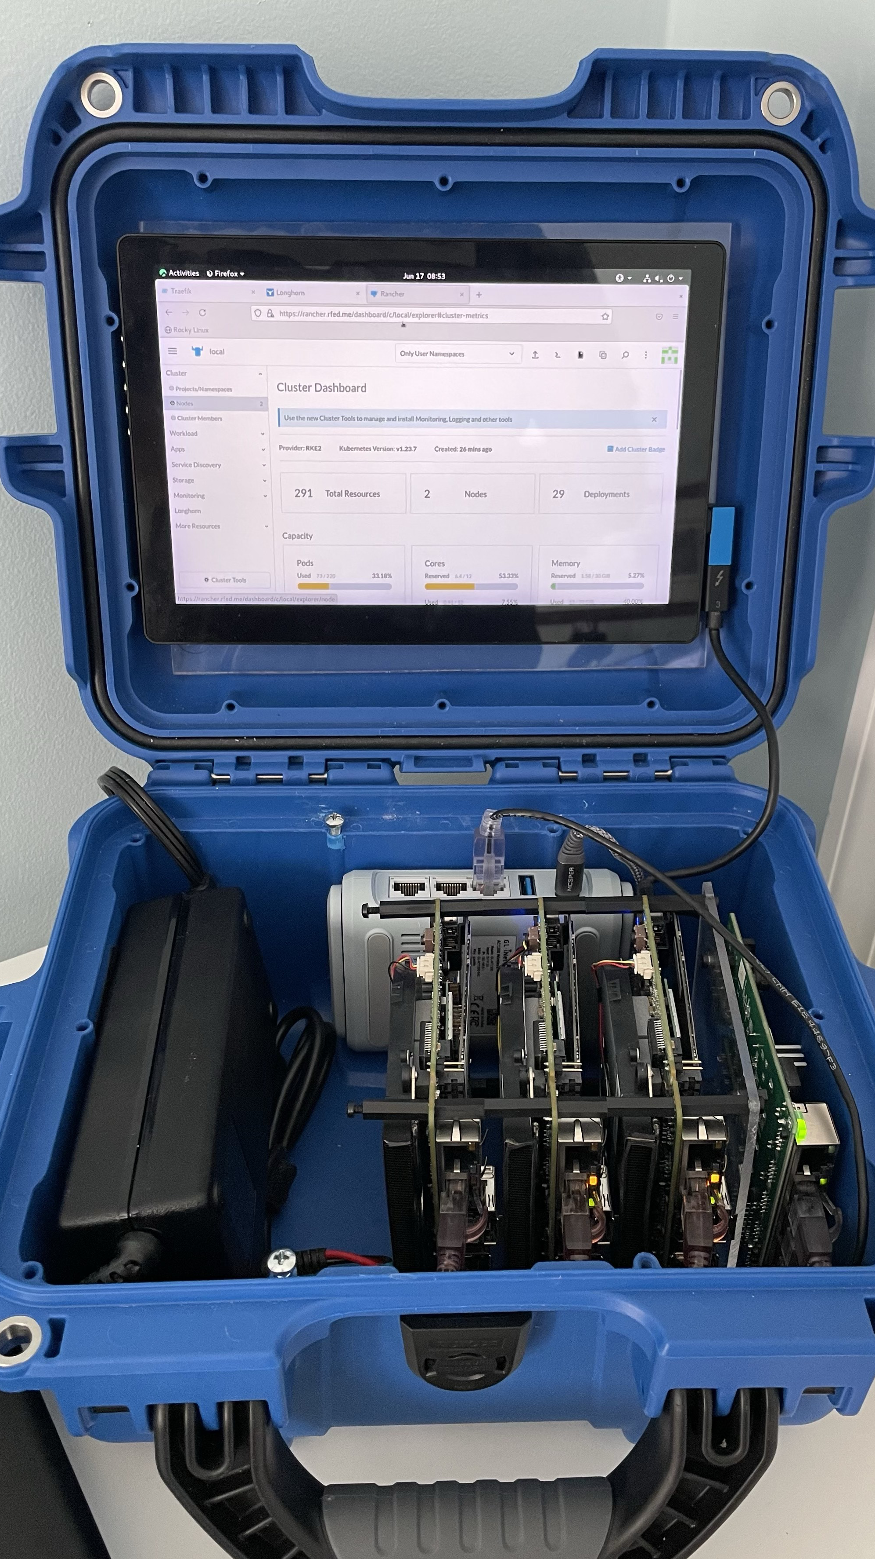
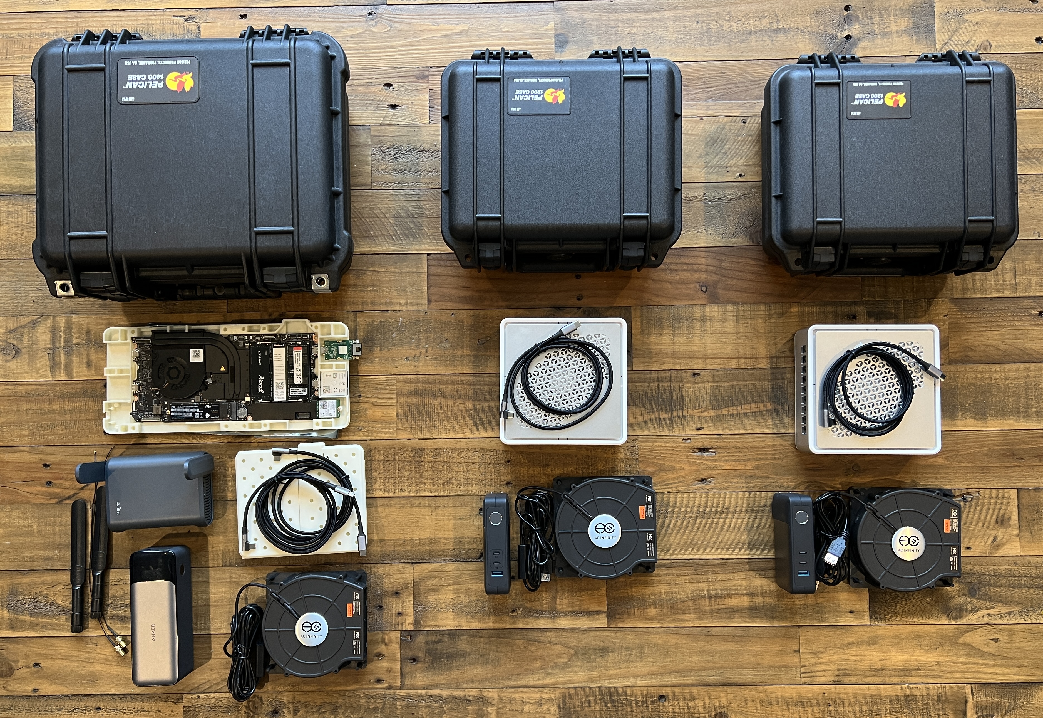
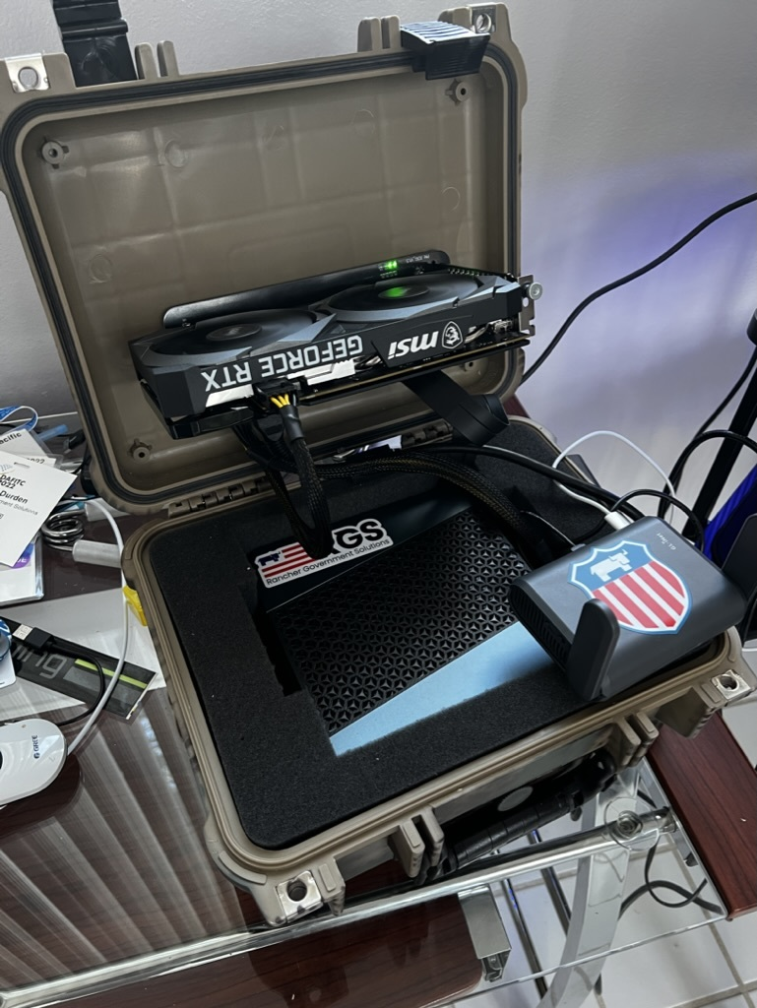
From Datacenters to the Edge…

Slide 13
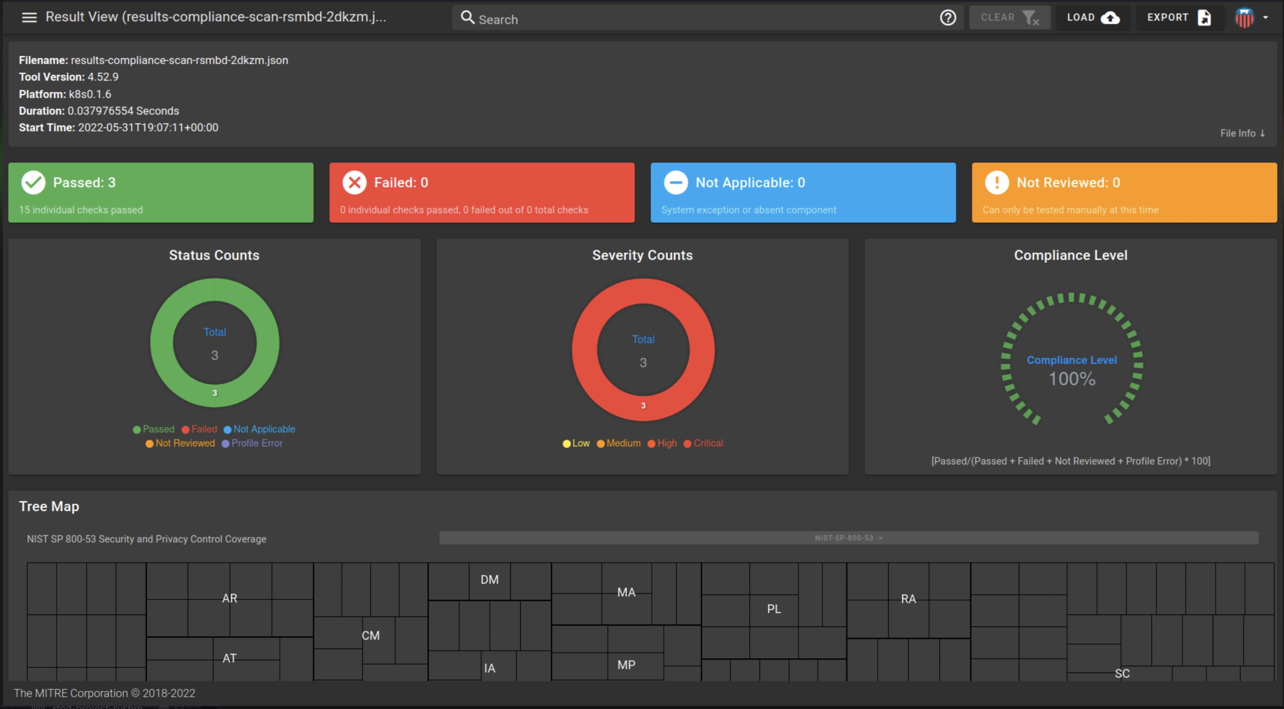
What’s Next for Rancher Federal…
Rancher Carbide
Secure/Trusted Container Registry
Automated STIG Validation (Stigatron)
SLSA3/SBOM’s
U.S. GOV ONLY
and more…

Slide 14
Thank you for your time today!
Email: zack.brady@rancherfederal.com
GitHub: https://github.com/zackbradys
Website: https://ranchergovernment.com
Cage Code: 8GLZ3
DUNS: 117387835

